Slide 1


Slide 2
Key Points: CPInsight™
Is a new framework designed to measure value creation
  It has Academic backing
  Built on Common sense
  It is easy to understand and implement
Will shift your perspective from profit to value
  CPInsight is the best metric out there for measuring financial performance
And it will establish finance as a competitive advantage
  Creates direct relationship between strategy, finance and execution
  It promotes the optimal allocation of capital
  Capital is a finite resource…the framework ensures its optimal use
Notes:
Virgin media O2 mega deal, ACT deal of the year award winner

Slide 3

Your presenter today, Ben Walters, FCT, ACA, is a practising Treasurer and Head of Corporate Finance. His framework, CPInsight™, has been developed over years of reconciling the demand to “maximise” the cash to the demand to “maximise” the value
Notes:
Strategy isn’t a disconnected process – it filters down into the financial performance of the business

Slide 4
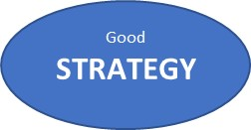


The Value Creation Hierarchy
1
People
GROWTH
2
For every £1 you put in you get more back!
Until now we’ve had no satisfactory way to measure return on capital
3
Accounting numbers:
Margin %, Eps, cash flow

Slide 5
What’s under the bonnet of CPInsight™
Warning: a tiny bit of Maths involved!

Slide 6
Measuring value is simply a case of analysing cash flow performance
iRoCE
Cash profit
What is the rate of return on this investment?

Slide 7
iRoCE
What is the rate of return on our investment spend of 100?
If our firm increases its cash profit YoY by 15 (from 180 to 195) then;
iRoCE¹ is 15 / 100 = c.15%²
Because iRoCE is calculated from Incremental underlying cash profit it means it is
A measure of the value being created in real time
FREE from corporate history (impairments / M&A) and accg adj.
FREE from impact of inflation
1. iRoCE = incremental Return on Capital Employed
2. An adjustment is made for significant differences in UeL/renewal costs

Slide 8
Empirical Evidence
Does CPInsight work?
CPInsight is the best metric for measuring financial performance

Slide 9
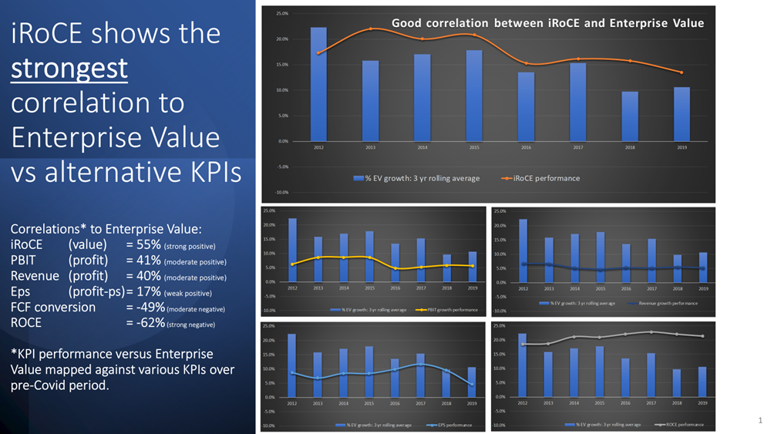

Slide 10
Academic backing
Two MBA students were mentored through their research projects*. Quotes from their reports include:
“CPInsight metrics provided clearer signals of value creation and destruction, consistently outperforming traditional measures in predictive accuracy.”
“… Importantly, CPInsight was shown to be both practical and feasible, as it can be calculated using publicly available data with only minor adjustments.”
“For practice, CPInsight™ offers managers a robust decision-making framework, investors a screening mechanism, and policymakers a tool for reforming corporate disclosure.
*Research involved significant data analysis of FTSE100 financial performance as measured under the CPInsight framework and correlation to changes in Enterprise Value. Projects were assessed and validated by academic staff at the University of Birmingham's business school

Slide 11
Application
How to use CPInsight in your organisation
CPInsight will enhance your finance function as a source of competitive advantage

Slide 12
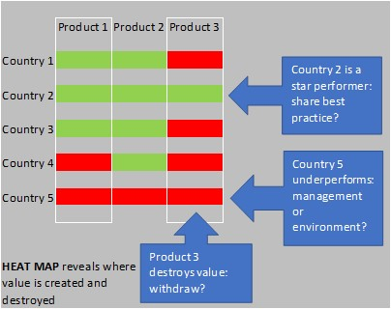
Capital Allocation
PERFORMANCE
Measuring value across your portfolio highlights where to allocate capital, or take remedial action, to maximise total value

Slide 13
Performance targets
PERFORMANCE
Budgeting becomes a two dimensional process when CPInsight sets targets
Set budget targets based on capital
e.g. capital allocated of 100, target iRoCE of 18%
  100 x 18% = +18 cash from operations YoY
  This value can easily be worked back into a revenue and PBIT targets

Slide 14
As a valuation tool
VALUATION
As a valuation tool for M&A, equity investors/analysts, hedge funds, lenders
CPInsight determines how much value an entity is creating and compares it to the market’s expectation
  Where CPInsight > market expectation the target is undervalued
  Where CPInsight < market expectation the target is Overvalued

Slide 15

CPInsight™ is:
Your CFO Super Power
To embed Value in your business contact Ben through LinkedIn or search www.treasury-insight.co.uk email: enlightenment@treasury-insight.co.uk
Confidentiality and intellectual property: the contents, ideas, illustrations and examples within this paper remain the sole property of the author at all times. They are not to be distributed or communicated in any form unless permitted by the author. Any use of the contents, ideas, illustrations and examples within this paper for commercial or academic purposes is expressly prohibited unless permitted by the author.

